Slide 1

Extending a Simulation Framework for Performance Assessment of Parallel Applications
Aditya Ujeniya
11th DEC 2023
With acknowledgements to Ayesha Afzal

Slide 2
Objectives
Intro to DisCostiC and its features
Framework modifications
Performance Analysis
Conclusion
Future Work

Slide 3




Motivation
Studying various effects of noise.
Large scale applications require time and resources.
Not so time and cost efficient.
DisCostiC offers accurate simulation of large scale application.

Slide 4


DisCostiC
Performance Modelling
Communication Modelling
LogGP
Hockney

Slide 5
Framework Design
COMP
comp = DisCosTiC->Exec(..., comm);
if (rank + 1 < systemsize)
{
int top = rank + 1;
send = DisCosTiC->Isend(..., comp);
recv = DisCosTiC->Irecv(..., comp);
}
if (rank > 0)
{
int bottom = rank - 1;
send = DisCosTiC->Isend(..., comp);
recv = DisCosTiC->Irecv(..., comp);
}
SEND
RECV
SEND
RECV
Code to Graph generation

Slide 6
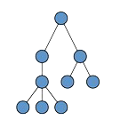
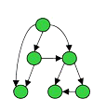
Static Analysis
//////////
//////////
///CODE///
//////////
//////////
DSEL ready code
Model
Analysis
Static Analysis
Symbol Table
Abstract Syntax Tree
Call Graph
Var | Val
a | 1
b | 2
c | 3

Slide 7
Execution Modes
FILE
SRC
LBL
COMP
Uses kerncraft in backend to derive ECM model values
Directly uses given ECM model values

Slide 8
Execution Modes
FILE
SRC
LBL
COMP
comp = DisCosTiC->Exec(FILE:STREAM.c//..., comm);
double a[N], b[N], c[N];
double s;
for(int i=0; i<N; ++i)
a[i] = b[i] + s * c[i];
STREAM.c

Slide 9
Execution Modes
FILE
SRC
LBL
COMP
comp = DisCosTiC->Exec(SRC:double a[N], b[N], c[N]; double s; for(int i=0; i<N; ++i) a[i] = b[i] + s * c[i]; //..., comm);

Slide 10
Execution Modes
FILE
SRC
LBL
COMP
comp = DisCosTiC->Exec(LBL:STREAM.cfg//..., comm);
#ECM
T_OL = 1.3
T_nOL = 1.0
T_L1L2 = 4.0
T_L2L3 = 12.0
T_L3Mem = 5.5
T_ECM = 22.5
T_MECM = 4.7
STREAM.cfg

Slide 11
Execution Modes
FILE
SRC
LBL
COMP
comp = DisCosTiC->Exec(COMP:T_OL = 1.3||T_nOL = 1.0|T_L1L2 = 4.0|T_L2L3 = 12.0|T_L3Mem = 5.5|T_ECM = 22.5|T_MECM = 4.7//..., comm);

Slide 12


Framework modifications – User feasibility
Standardization of tool using Cmake.
Less parameterization.
Segregated network configuration files.
  Intrachip
  Interchip
  Internode (Omnipath, Infiniband)

Slide 13
Framework modifications – User feasibility
SLURM feature –tasks_per_node (may also be considered compact pinning)
Node 0
Node 1
Node 0
Node 1
tasks_per_node = 16
# process = 10
tasks_per_node = 6
# process = 10

Slide 14
Framework modifications – Simulation Efficiency

Slide 15
Framework modifications – Simulation Accuracy
FILE
SRC
LBL
COMP
Uses kerncraft in backend to derive ECM model values
Given ECM model values, handles extra penalties not covered by kerncraft

Slide 16
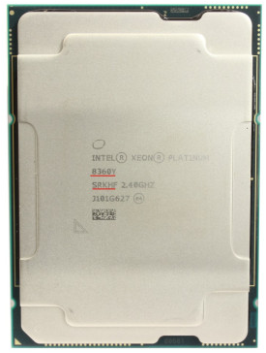
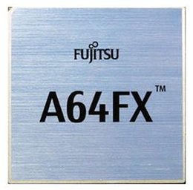
Framework portability – Heterogenous systems
Interconnect
A64FX Nodes
8360Y Nodes

Slide 17
Testbed for Performance Analysis – Fritz & Meggie

Slide 18
Testbed for Performance Analysis - Wisteria

Slide 19
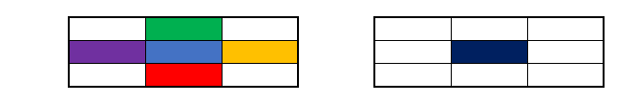
Performance Analysis – SOR kernel
double src[jmax][imax];
double rhs[jmax][imax];
for( int j=1; j < jmax+1; ++j )
{
for( int i=1; i < imax+1; ++i )
{
r1 = rhs[j][i] - ( ( src[j][i-1] - 2.0 * src[j][i] + src[j][i+1] ) * idx2 + ( src[j-1][i] - 2.0 * src[j][i] + src[j+1][i] ) * idy2 );
src[j][i] = src[j][i] - ( factor * r1 );
res = res + ( r1 * r1 );
}
}
SRC matrix
RHS matrix

Slide 20
Performance Analysis – SOR kernel
Arithmetic : 96 cy/CL
Registers
20 cy/CL
L1
5 cy/CL
L2
8 cy/CL
L3
4 cy/CL
MEM
ECM Model for 8360Y

Slide 21
Performance Analysis – SOR kernel

Slide 22
Performance Analysis – SOR kernel

Slide 23
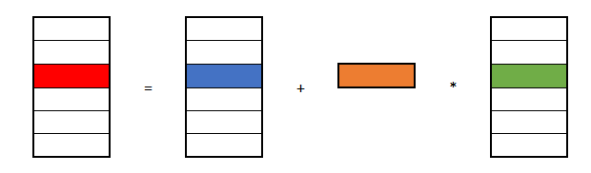
Performance Analysis – STREAM kernel
double a[N], b[N], c[N];
double s;
for( int i=0; i < N; ++i )
{
a[i] = b[i] + s * c[i];
}

Slide 24
Performance Analysis – STREAM kernel
Arithmetic : 1.3 cy/CL
Registers
1 cy/CL
L1
4 cy/CL
L2
12 cy/CL
L3
5.5 cy/CL
MEM
ECM Model for 8360Y

Slide 25
Performance Analysis – STREAM kernel

Slide 26
Performance Analysis – STREAM kernel

Slide 27
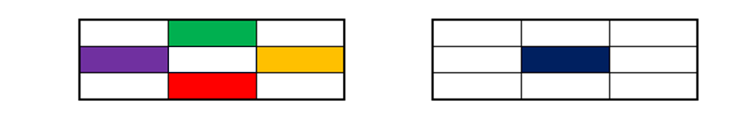
Performance Analysis – HEAT kernel on Wisteria
double src[dim_y][dim_x];
double dst[dim_y][dim_x];
for ( int y = 1; y < dim_y; ++y )
{
for ( int x = 1; x < dim_x; ++x )
{
dst[y][x] = 0.25 * ( src[y][x - 1] + src[y][x + 1]
+ src[y - 1][x] + src[y + 1][x] );
}
}
SRC matrix
DST matrix

Slide 28
Performance Analysis – HEAT kernel on Wisteria
Arithmetic : 2 cy/CL
Arithmetic : 2 cy/CL
Registers
Registers
8 cy/CL
8 cy/CL
L1
L1
8 cy/CL
32 cy/CL
L2
L2
8 cy/CL
64 cy/CL
MEM
L3
84 cy/CL
ECM Model for A64FX
FX1000
MEM
ECM Model for 8360Y

Slide 29
Performance Analysis – HEAT kernel on Wisteria

Slide 30
Performance Analysis – HEAT kernel on Wisteria

Slide 31
Blank

Slide 32
Future work

